Slide 1
Design Patterns Strategy Pattern
Lecture 6
Teacher: Baida’a Lala’a

Slide 2
Strategy Pattern
Strategy is a behavioral design pattern that lets you define a family of algorithms, put each of them into a separate class, and make their objects interchangeable.

Slide 3
Strategy Design Pattern is preferred to use within the applications where the underlying algorithms need to be selected at runtime.
Strategy Pattern suggests introducing an interface, which can enable the functionality to choose the algorithm at run time.
Strategy pattern follows the Open/close principle; a software application is open for extension but closed for modification. It means you can add any number of additional strategies without modifying the main class. It makes your code more flexible and easy to maintain.
Use the pattern when your class has a massive conditional operator that switches between different variants of the same algorithm.

Slide 4
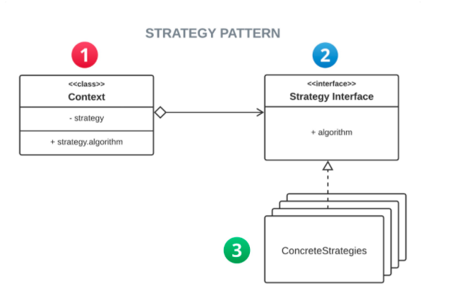

Slide 5
Problem
One day you decided to create a navigation app for casual travelers. The app was centered around a beautiful map which helped users quickly orient themselves in any city.
One of the most requested features for the app was automatic route planning. A user should be able to enter an address and see the fastest route to that destination displayed on the map.
The first version of the app could only build the routes over roads. People who traveled by car were bursting with joy. But apparently, not everybody likes to drive on their vacation. So with the next update, you added an option to build walking routes. Right after that, you added another option to let people use public transport in their routes.
However, that was only the beginning. Later you planned to add route building for cyclists. And even later, another option for building routes through all of a city’s tourist attractions.

Slide 6
While from a business perspective the app was a success, the technical part caused you many headaches. Each time you added a new routing algorithm, the main class of the navigator doubled in size. At some point, the beast became too hard to maintain.
Any change to one of the algorithms, whether it was a simple bug fix or a slight adjustment of the street score, affected the whole class, increasing the chance of creating an error in already-working code.
In addition, teamwork became inefficient. Your teammates, who had been hired right after the successful release, complain that they spend too much time resolving merge conflicts. Implementing a new feature requires you to change the same huge class, conflicting with the code produced by other people.

Slide 7
Solution
The Strategy pattern suggests that you take a class that does something specific in a lot of different ways and extract all of these algorithms into separate classes called strategies.
The original class, called context, must have a field for storing a reference to one of the strategies. The context delegates the work to a linked strategy object instead of executing it on its own.
The context isn’t responsible for selecting an appropriate algorithm for the job. Instead, the client passes the desired strategy to the context. In fact, the context doesn’t know much about strategies. It works with all strategies through the same generic interface, which only exposes a single method for triggering the algorithm encapsulated within the selected strategy.
This way the context becomes independent of concrete strategies, so you can add new algorithms or modify existing ones without changing the code of the context or other strategies.

Slide 8
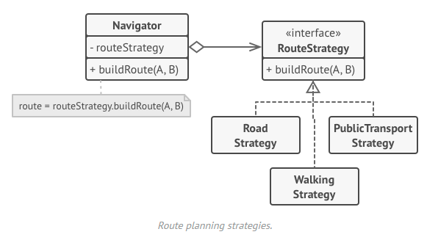

Slide 9
Context interface: Interface that keeps a reference to all available strategies(algorithm).
class Cotext:
def __init__(self, strategy): self._strategy = strategy
def context_interface(self): self._strategy.algorithm_interface()

Slide 10
Strategy interface: An abstract interface, defining the structure for all the available concrete strategies.
class Strategy():
@abstractmethod
def algorithm_interface(self): pass

Slide 11
Concrete Strategy Interfaces: Interfaces implementing all available strategies(i.e algorithms).
class Strategy_A(Strategy):
"""Implementation of Algotihms"""
def algorithm_interface(self):
Pass
class Strategy_B(Strategy):
def algorithm_interface(self):
pass

Slide 12
Example: An application deciding which discount offer to apply on shopping amount. Product class, serving as context class.
class Product:
"""Context class""“
def __init__(self, price, strategy = None):
self.price = price
self.strategy = strategy
def price_after_discount(self):
if self.strategy:
discount = self.strategy.discount(self.price)
else:
discount = 0
return self.price - discount
def __str__(self):
return f"Price: {self.price}, price after discount: {self.price_after_discount()}"

Slide 13
Concrete strategies
class Sale_Discount:
def discount(price):
return price * 0.25 + 20
class Regular_Discount:
def discount(price):
return price * 0.20

Slide 14
The Client Code
if __name__ == "__main__":
print(Product(20000))
print(Product(20000, strategy = Sale_Discount)) print(Product(20000, strategy = Regular_Discount))
Price: 20000, price after discount: 20000 Price: 20000, price after discount: 14980.0 Price: 20000, price after discount: 16000.0

